Slide 1
A structural equation model of political instability, religiosity, and progressive values
Presented by
Fred Pasquarella & Greg Johnson

Slide 2
Background
Background Information
Lit Review
Our hypothesis
In words:
Graphically
Poli
Rel
Prog

Slide 3
Research process
Specify Model.
Evaluate Identification.
Operationalize & Screen Data.
Indicator Validity.
Assumption Checks.
Estimate Model.
Evaluate Fit.
Interpret Parameter Estimates.
Re-Specify Model.
Compare to Previous Model(s).
Interpret Model

Slide 4
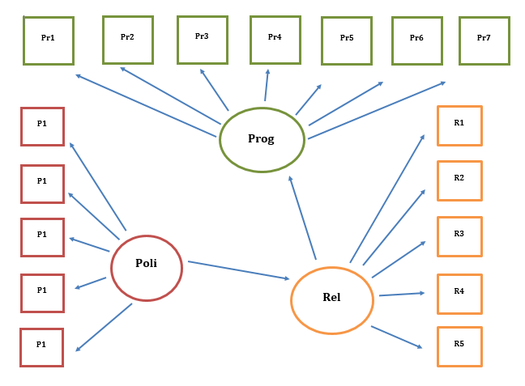
Specify model: path diagram
Structural Equation Model = Measurement Models + Latent Structure Model
Notes:
These are the measurement portions of the model. Basically little CFAs.
This is the structural portion, where we posit an effect order or causal order, which is fully latent because all variables are latent.

Slide 5
identification
Definition: there exists a unique solution for all parameters in the model.
Rule: fully recursive models are always identified.

Slide 6
secondary data source
World Values Survey
Selection criteria for final items

Slide 7
Secondary data source ii

Slide 8
Measurement I
Indicator content validity: domain-sampling model
Items | P1 | P2 | P3 | P4 | P5 | R1 | R2 | R3 | R4 | R5 | Pr1 | Pr2 | Pr3 | Pr4 | Pr5 | Pr6 | Pr7
P1
P2 | .48
P3 | .38 | .65
P4 | .42 | .53 | .58
P5 | .30 | .41 | .47 | .57
R1 | .13 | -.05 | .01 | .11 | .05
R2 | .09 | -.03 | .00 | .08 | .02 | .50
R3 | .32 | .16 | .19 | .26 | .21 | .53 | .39
R4 | .09 | -.03 | .01 | .10 | .05 | .60 | .41 | .49
R5 | -.12 | .06 | .04 | -.07 | .02 | -.71 | -.44 | -.48 | -.54
Pr1 | .07 | -.05 | -.04 | .05 | .01 | .29 | .22 | .19 | .23 | -.25
Pr2 | .16 | -.03 | .00 | .10 | .06 | .44 | .32 | .30 | .35 | -.39 | .43
Pr3 | .10 | -.04 | .00 | .08 | .03 | .44 | .30 | .28 | .35 | -.42 | .26 | .61
Pr4 | .15 | .06 | .05 | .12 | .05 | .22 | .17 | .20 | .17 | -.18 | .22 | .27 | .21
Pr5 | .15 | .04 | .04 | .14 | .07 | .23 | .17 | .23. | .20 | -.20 | .22 | .32 | .22 | .41
Pr6 | .09 | .03 | .00 | .08 | .06 | .13 | .10 | .14 | .15 | -.11 | .11 | .19 | .17 | .32 | .47
Pr7 | .13 | .03 | .04 | .13 | .07 | .24 | .20 | .24 | .22 | -.19 | .24 | .31 | .22 | .42 | .69 | .54
Political Instability
Progressiveness
Religiosity
Notes:
Moderate, positive inter-item correlations

Slide 9
Measurement ii
Indicator construct validity: integrity of indicators
How to Check?
Perform 3 EFAs to examine complexity of indicators
Political Instability indicators: unidimensional
Religiosity indicators: unidimensional
Progressiveness indicators: unidimensional
L₁
L₂
L₁
L₂
I₁
I₂
I₁
I₂

Slide 10
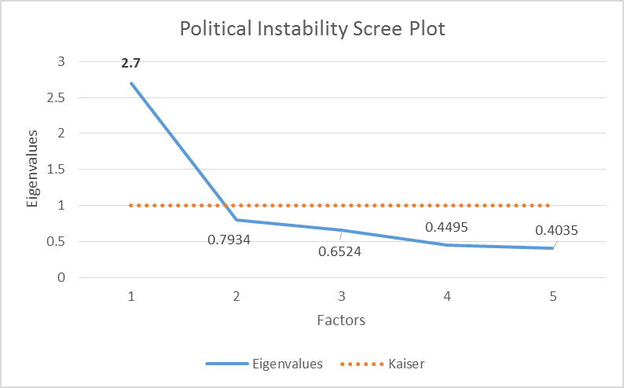
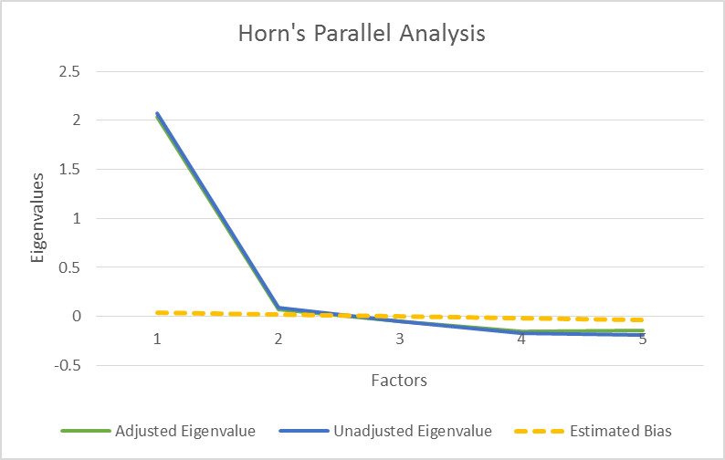
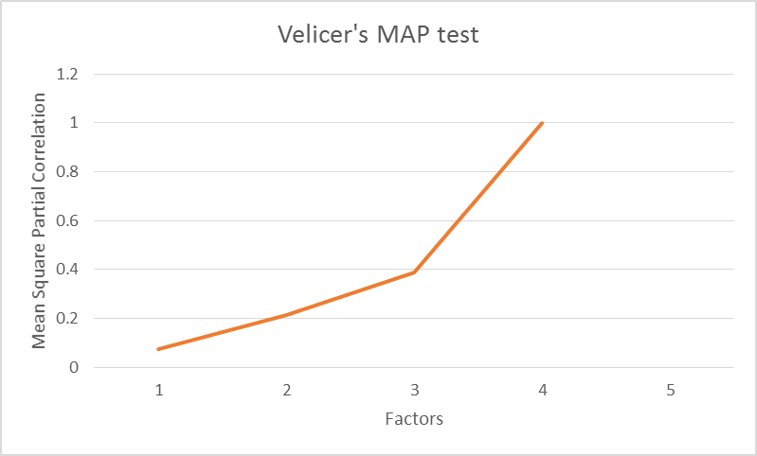
Measurement iii
Political Instability Construct – 54% variance explained by 1st Factor
Variable | Factor | Communality
Confidence in Armed Forces | 0.47 | 0.222
Confidence in the Police | 0.72 | 0.333
Confidence in the Justice System | 0.75 | 0.399
Confidence in the Government | 0.71 | 0.408
Confidence in the Political Parties | 0.60 | 0.266

Slide 11
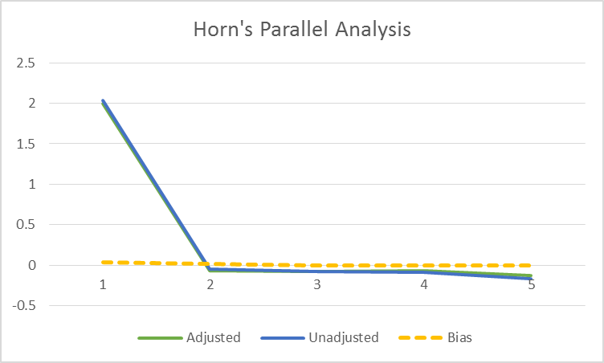
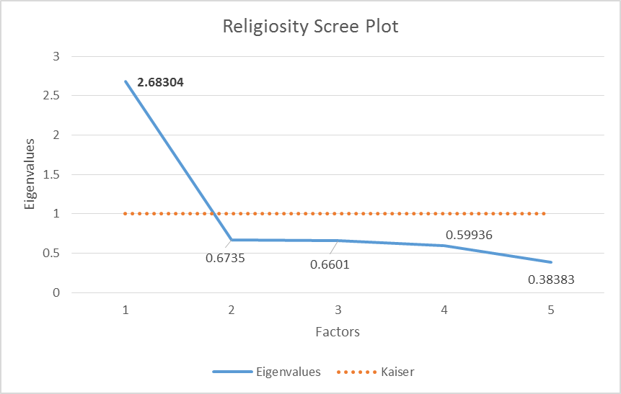
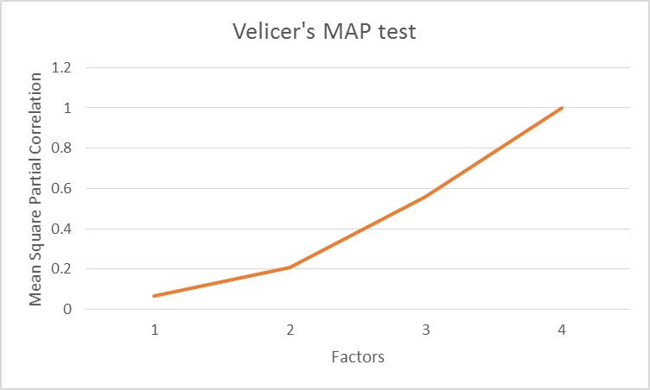
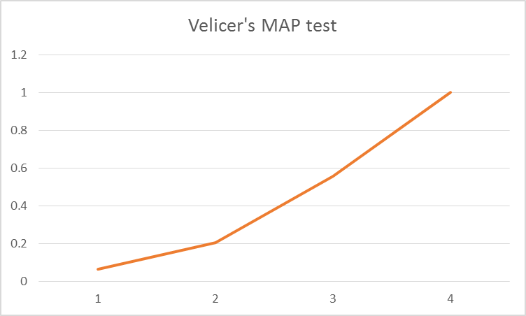
Measurement iv
Religiosity Construct – 53% variance explained by 1st Factor
Variable | Factor | Communality
Importance of Religion | 0.81 | 0.686
Importance of Having Faith | 0.57 | 0.314
Confidence in Churches | 0.56 | 0.296
Frequency of Service Attendance | 0.55 | 0.285
Importance of God in Life | 0.73 | 0.537

Slide 12
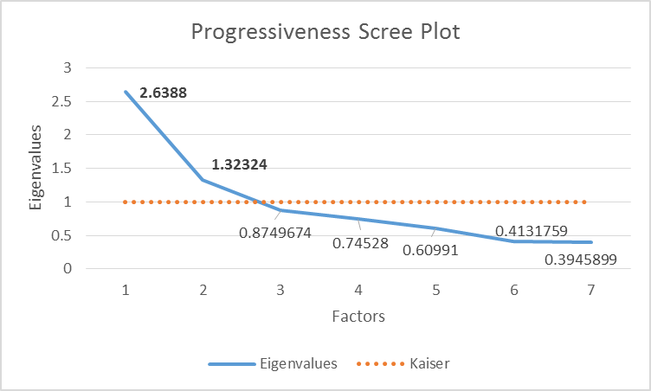
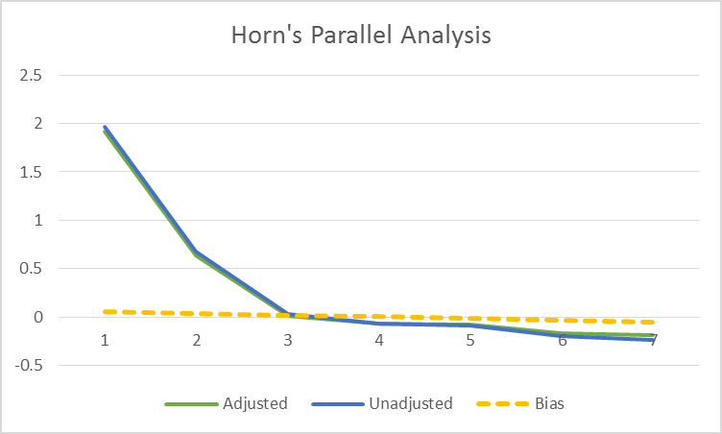
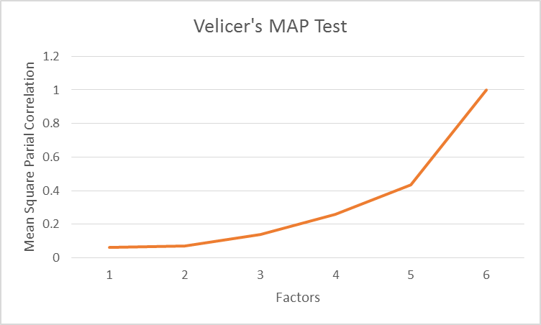
Measurement v
Progressiveness Construct
38% variance explained by 1st factor
57% variance explained by 2nd factor
Looks bidimensional – trouble?

Slide 13
Measurement vi
Progressiveness: 1 Factor Solution (what we want)
Variable | Factor | Communality
Homosexual Neighbors Okay | 0.25 | 0.084
Homosexuality Justifiable | 0.42 | 0.115
Abortion Justifiable | 0.33 | 0.055
Men Have More Right to Jobs | 0.46 | 0.078
Men Are Better Politicians | 0.71 | 0.083
Higher Edu More Important for Men | 0.57 | 0.034
Men Are Better Executives | 0.76 | 0.074
Progressiveness: 2 Factor Solution, Varimax Rotation
Variable | Factor 1 | Factor 2 | Communality
Homosexual Neighbors Okay | 0.14 | 0.29 | 0.084
Homosexuality Justifiable | 0.14 | 0.91 | 0.115
Abortion Justifiable | 0.11 | 0.63 | 0.055
Men Have More Right to Jobs | 0.39 | 0.21 | 0.078
Men Are Better Politicians | 0.68 | 0.18 | 0.083
Higher Edu More Important for Men | 0.59 | 0.08 | 0.034
Men Are Better Executives | 0.80 | 0.15 | 0.074

Slide 14
assumption checks
Normality (not a big deal because we used MLE)
Outliers
Etc.
R Matrix is Positive-Definite

Slide 15
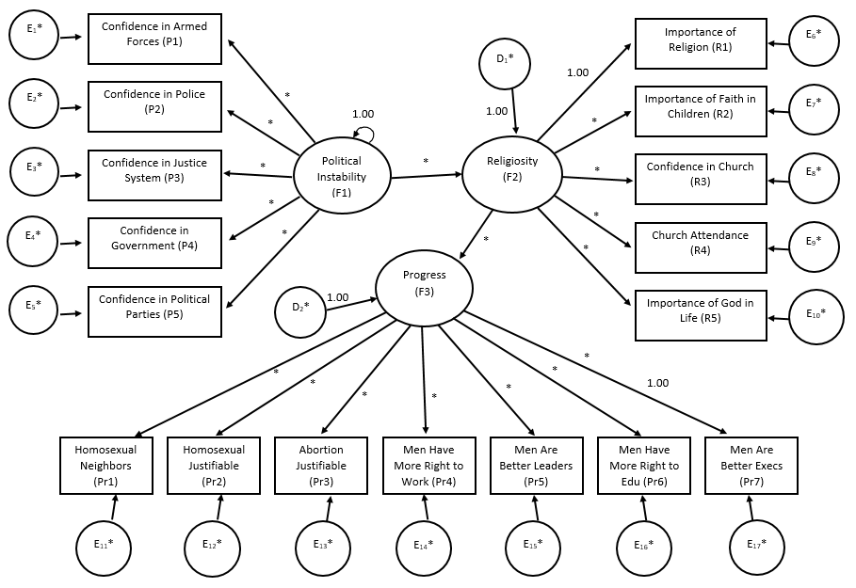

Slide 16
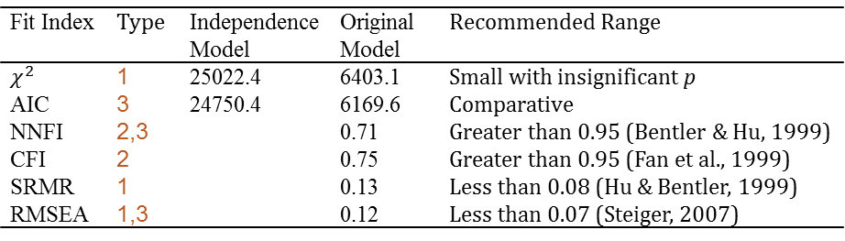
Estimate model II
Types of Fit Indices
Absolute: proportion of sample covariances explained by the model.
Comparative: relative improvement over baseline model.
Parsimony-adjusted: accounts for model complexity.
Original Model Fit:
Fit Index | Type | Independence Model | Original Model | Recommended Range
$χ^{2}$ | 1 | 25022.4 | 6403.1 | Small with insignificant p
AIC | 3 | 24750.4 | 6169.6 | Comparative
NNFI | 2,3 |  | 0.71 | Greater than 0.95 (Bentler & Hu, 1999)
CFI | 2 |  | 0.75 | Greater than 0.95 (Fan et al., 1999)
SRMR | 1 |  | 0.13 | Less than 0.08 (Hu & Bentler, 1999)
RMSEA | 1,3 |  | 0.12 | Less than 0.07 (Steiger, 2007)
Conclusion: unilateral poor fit.

Slide 17
re-specify model
Lagrange Multiplier Test: parameters to add to increase model fit.
Measurement Problem?
Let’s re-examine the validity of our indicators.

Slide 18
Re-specify model III
3 Factor Solution, Oblique Rotation using Yates Geomin Criterion
Variable | Factor 1 | Factor 2 | Factor 3
Confidence in Armed Forces | 0.54 | 0.12 | 0.06
Confidence in the Police | 0.78 | -0.10 | -0.03
Confidence in the Justice System | 0.80 | -0.04 | -0.05
Confidence in the Government | 0.74 | 0.07 | 0.04
Confidence in the Political Parties | 0.62 | 0.01 | 0.00
Importance of Religion | 0.01 | 0.87 | -0.03
Importance of Having Faith | 0.00 | 0.57 | 0.01
Confidence in Churches | 0.26 | 0.59 | 0.03
Frequency of Service Attendance | 0.01 | 0.69 | 0.00
Importance of God in Life | 0.03 | 0.82 | 0.06
Homosexual Neighbors Okay | -0.05 | 0.30 | 0.19
Homosexuality Justifiable | 0.00 | 0.47 | 0.23
Abortion Justifiable | -0.01 | 0.51 | 0.11
Men Have More Right to Jobs | 0.05 | 0.10 | 0.46
Men Are Better Politicians | 0.01 | 0.01 | 0.79
Higher Edu More Important for Men | -0.01 | -0.05 | 0.63
Men Are Better Executives | -0.01 | -0.01 | 0.86
Variable | F1 | F2 | F3
F1: Political Instability
F2: Religiosity | 0.06
F3: Progressiveness | 0.13 | 0.35
Dammit
Solution: distill Progressiveness down to just Gender Equality

Slide 19
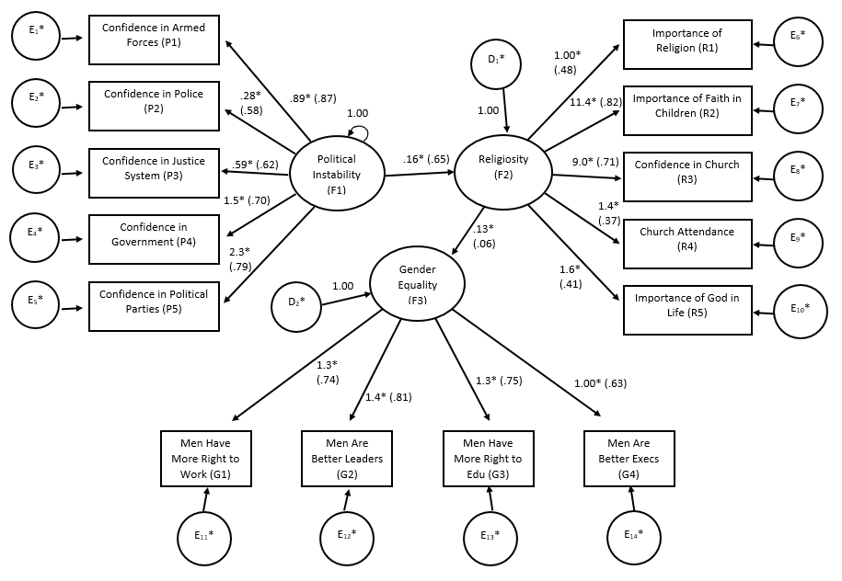

Slide 20
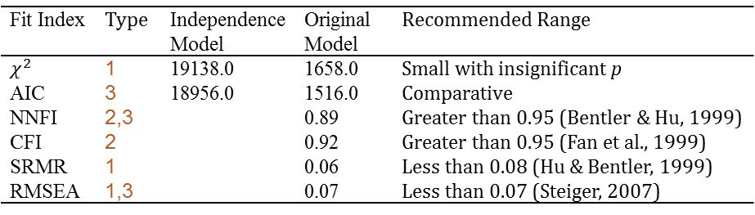
Re-specify model v
Types of Fit Indices
Absolute
Comparative
Parsimony-adjusted
Modified Model Fit
Fit Index | Type | Independence Model | Original Model | Recommended Range
$χ^{2}$ | 1 | 19138.0 | 1658.0 | Small with insignificant p
AIC | 3 | 18956.0 | 1516.0 | Comparative
NNFI | 2,3 |  | 0.89 | Greater than 0.95 (Bentler & Hu, 1999)
CFI | 2 |  | 0.92 | Greater than 0.95 (Fan et al., 1999)
SRMR | 1 |  | 0.06 | Less than 0.08 (Hu & Bentler, 1999)
RMSEA | 1,3 |  | 0.07 | Less than 0.07 (Steiger, 2007)
Conclusion: moderate fit.

Slide 21
Overall Results
General interpretation. Direct effects between latent factors. Indirect effect between PI and WR

Slide 22
Limitations & Future directions
Limitations
a
Future Directions
a

